Slide 1

CSCI 132: Basic Data Structures and Algorithms
Lecture 2: Computers, Coding, and Java
Reese Pearsall
Spring 2023
https://www.cs.montana.edu/pearsall/classes/spring2023/132/main.html
*All images are stolen from the internet

Slide 2
Announcements
Fill out the course questionnaire
Lab 1 posted (Due 1/24) (really easy)
Make sure you get an IDE downloaded before next week

Slide 3
You won’t be tested over any of today’s content
This is just helpful background information ☺

Slide 4
Computer Science is the study of computers, computation, and how we can use computers to solve problems

Slide 5


Computer Science is the study of computers, computation, and how we can use computers to solve problems
What is the optimal route from Kalispell to Glendive?

Slide 6
Computer Science is the study of computers, computation, and how we can use computers to solve problems
How to sort a list of integers from least to greatest?

Slide 7
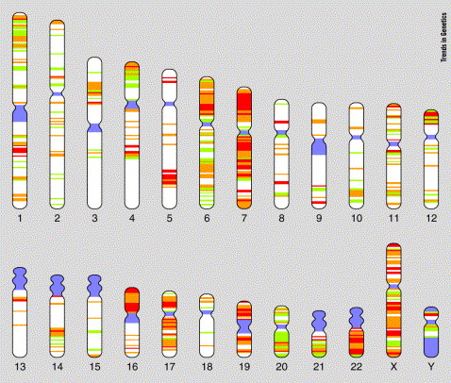
Computer Science is the study of computers, computation, and how we can use computers to solve problems
How to sequence the human genome?

Slide 8

Computer Science is the study of computers, computation, and how we can use computers to solve problems
How to defend a network and prevent intrusions?

Slide 9
Computer Science is the study of computers, computation, and how we can use computers to solve problems
Software Engineering
Data Science
Operating Systems
Web Development
Cybersecurity
Machine Learning
Programming Language Design
System Administration
Mobile Computing
Artificial Intelligence
Data Mining
Human Computer Interaction
Theoretical CS
Cloud Computing
Algorithms
Computer Graphics
Computer Vision / Robotics
Computer Networks
Computational Biology

Slide 10

What is a computer?

Slide 11

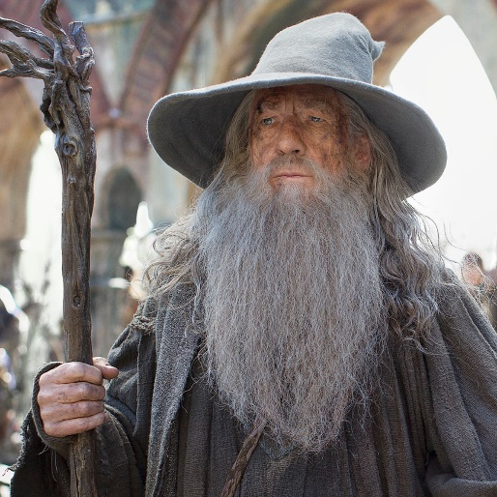
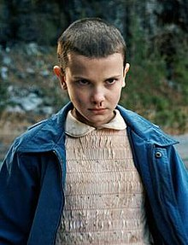

What is a computer?
A magical box that does stuff

Slide 12
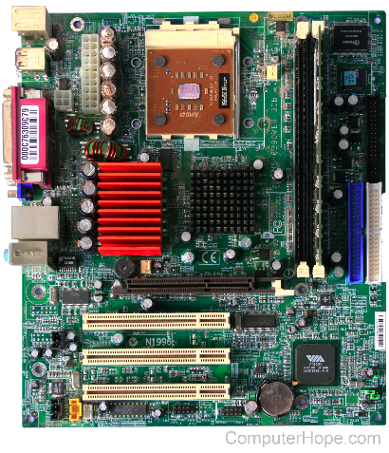
What is a computer?
A semi-magical box that does stuff executes instructions

Slide 13



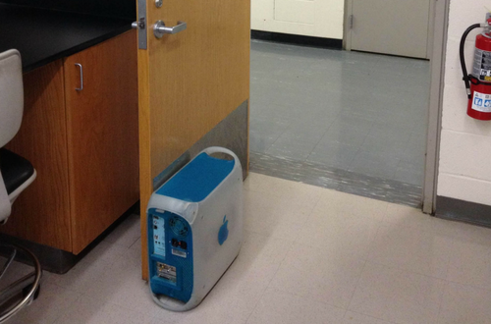
What is so magical about a computer?
We use computers every day for many different things
But,

Slide 14


What is so magical about a computer?
We use computers every day for many different things
But,
Big Idea
Computers only understand instructions in the form of 0s and 1s (binary)
01010111 01100101 01101100 01100011 01101111 01101101 01100101 00100000 01110100 01101111 00100000 01000011 01010011 01000011 01001001 00100000 00110100 00110111 00110110
Welcome to CSCI 132

Slide 15
How does this happen?
From a high level, we will divide a computer system into two parts
???????
??????

Slide 16
How does this happen?
From a high level, we will divide a computer system into two parts
???????
I. Hardware
Hardware

Slide 17
How does this happen?
From a high level, we will divide a computer system into two parts
From a high level, we will divide a computer system into two parts
Software
Hardware
Software
Hardware

Slide 18
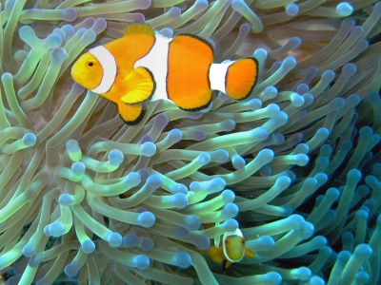
How does this happen?
From a high level, we will divide a computer system into two parts
From a high level, we will divide a computer system into two parts
Software
Hardware
Software
Hardware
Symbiotic relationship

Slide 19
How does this happen?
From a high level, we will divide a computer system into two parts
From a high level, we will divide a computer system into two parts
Software
Hardware
Software
Hardware
Symbiotic relationship

Slide 20
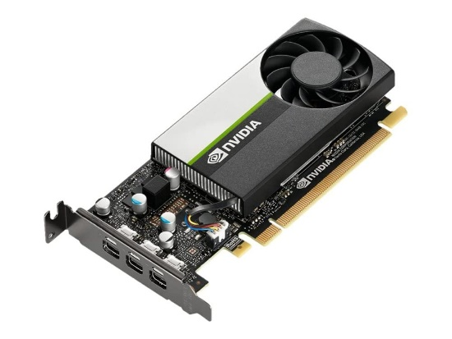
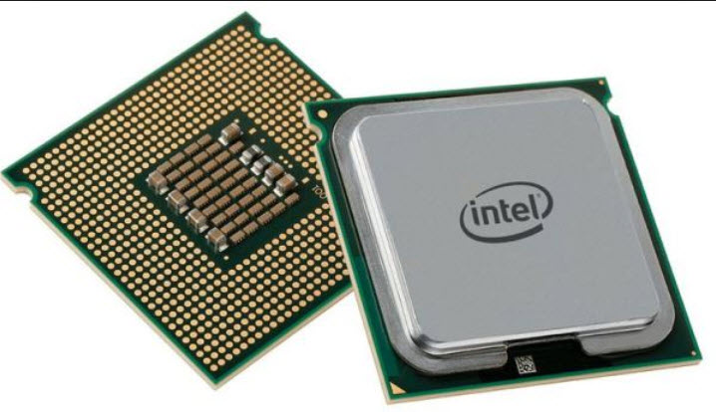
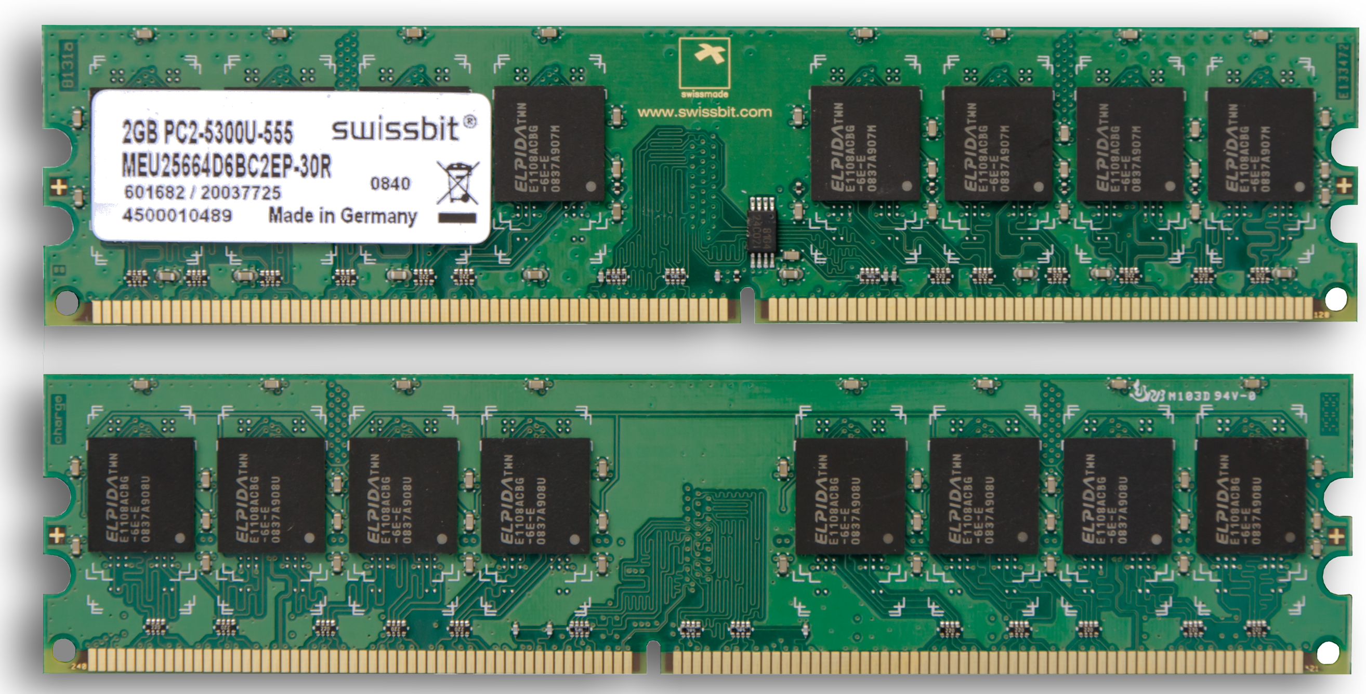
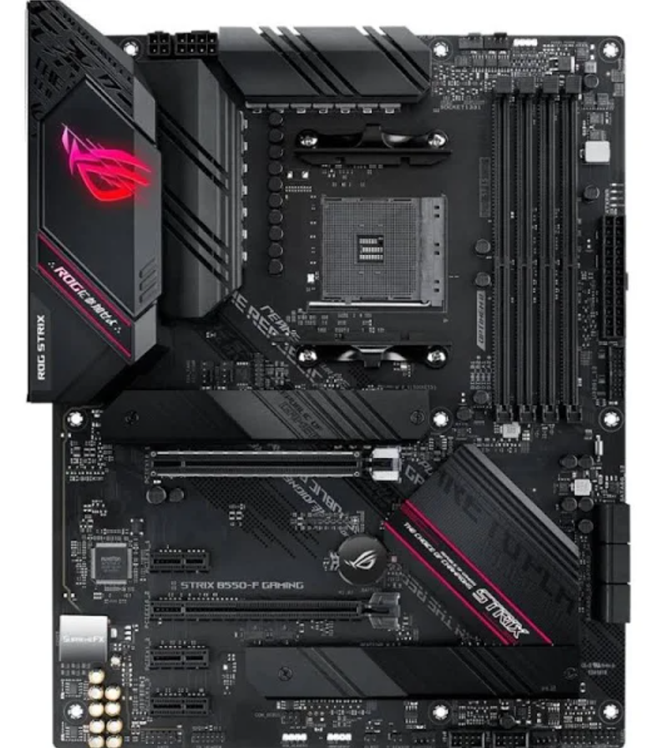
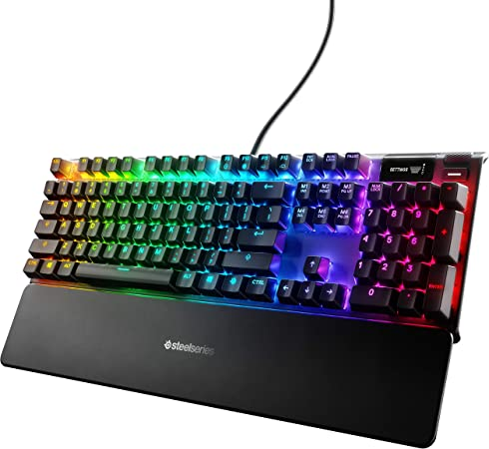
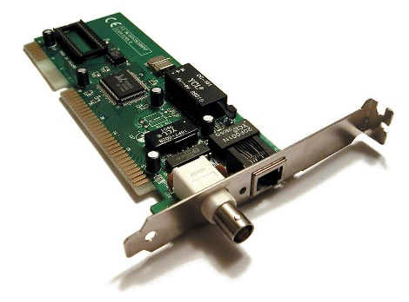
I. Hardware
The physical parts of a computer

Slide 21
I. Hardware
CPU
Memory

Slide 22
I. Hardware
Brain with no short-term memory
Scratch Pad
CPU
Memory

Slide 23

I. Hardware
Brain with no short-term memory
CPU
How does it “execute” instructions?
The CPU receives instructions from another part of the computer
0011011010110101001

Slide 24
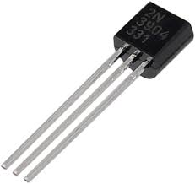
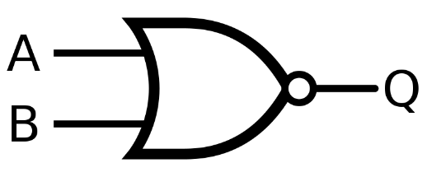
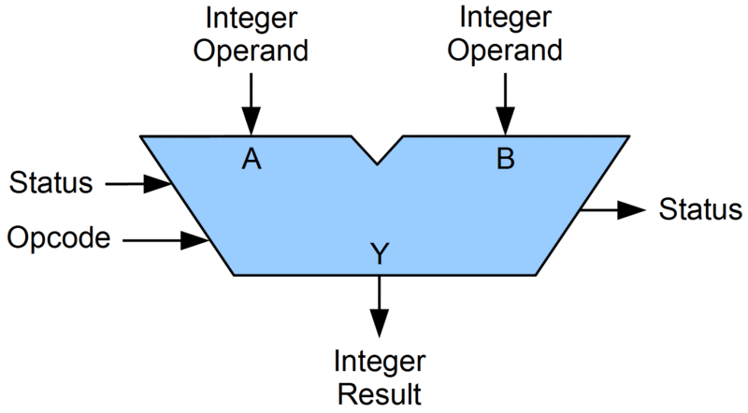
I. Hardware
Brain with no short-term memory
CPU
How does it “execute” instructions?
The CPU receives instructions from another part of the computer
0011011010110101001
CPU deciphers these instructions by using
Electricity™
The CPU then executes the appropriate operation based on the instruction

Slide 25
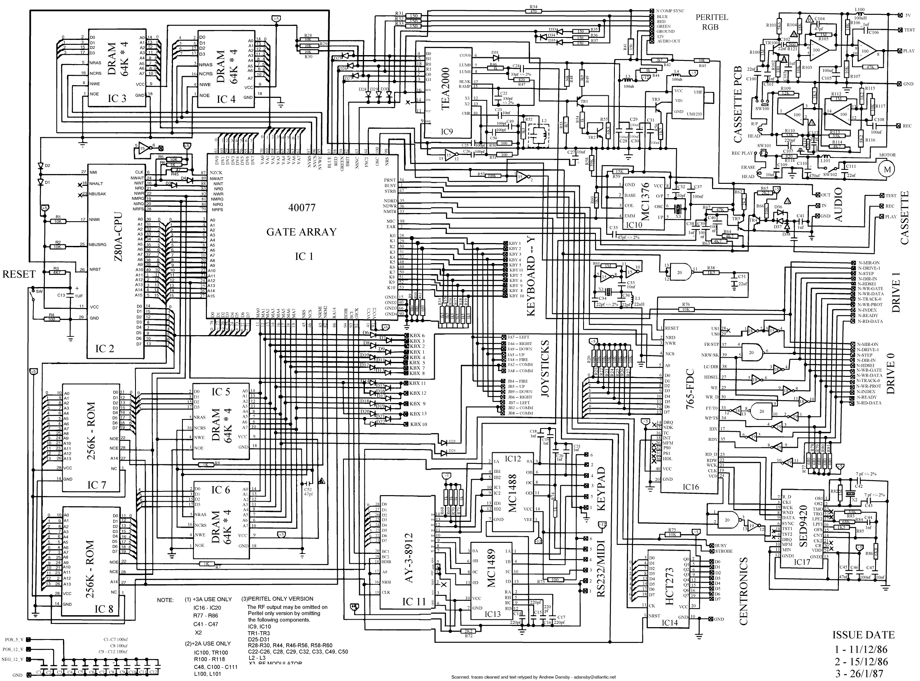
I. Hardware
Brain with no short-term memory
CPU
How does it “execute” instructions?
The CPU receives instructions from another part of the computer
0011011010110101001
CPU deciphers these instructions by using
Electricity™
The CPU then executes the appropriate operation based on the instruction

Slide 26
I. Hardware
Brain with no short-term memory
CPU
How does it “execute” instructions?
The CPU receives instructions from another part of the computer
0011011010110101001
CPU deciphers these instructions by using
Electricity™
The CPU then executes the appropriate operation based on the instruction

Slide 27
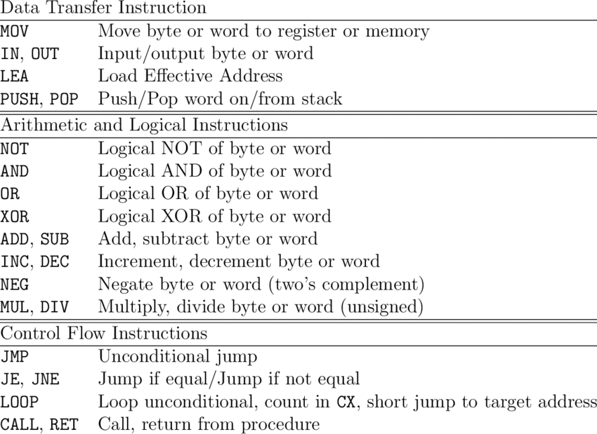
I. Hardware
Brain with no short-term memory
CPU
The CPU then executes the appropriate operation based on the instruction
Instructions consists of a small set (200-400) very basic operations
(Add stuff, move stuff, check a condition, etc)

Slide 28
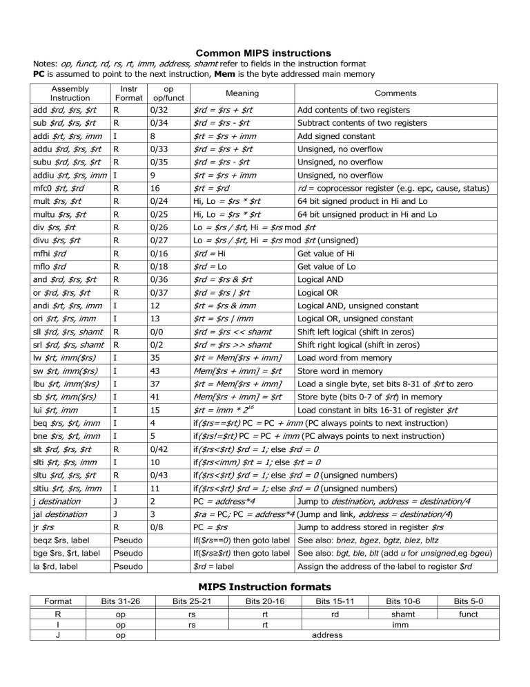
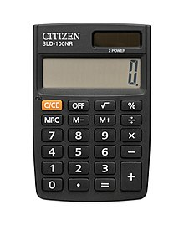
I. Hardware
Brain with no short-term memory
Scratch Pad
CPU
Memory
Must decipher what instruction to execute
The CPU can add, subtract, logic, move stuff around

Slide 29
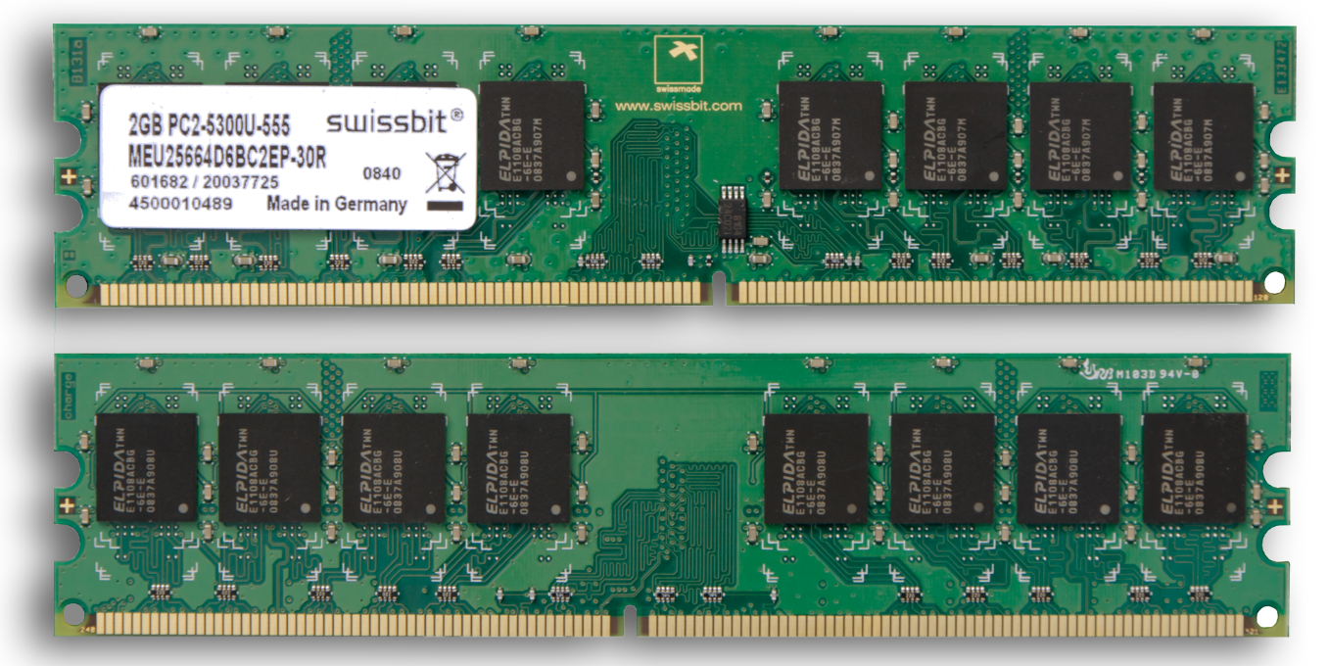
I. Hardware
When computer programs are executed, their instructions will eventually get stored in memory
Scratch Pad
Memory
Temporary storage
Instructions are stored here and prepared for the CPU
Instruction1
Instruction2
Instruction3
Instruction4
..
..
…
RAM (Random Access Memory)

Slide 30
I. Hardware
Brain with no short-term memory
Scratch Pad
CPU
Memory
Must decipher what instruction to execute
Temporary Storage
The CPU can add, subtract, logic, move stuff around
Sends instructions to the CPU

Slide 31


I. Hardware
Brain with no short-term memory
Scratch Pad
CPU
Memory
Must decipher what instruction to execute
Temporary Storage
Fetch Next Instruction
Decode and Execute
The CPU can add, subtract, logic, move stuff around
Sends instructions to the CPU

Slide 32


I. Hardware
Brain with no short-term memory
Scratch Pad
CPU
Memory
Do this forever…
Must decipher what instruction to execute
Temporary Storage
Fetch Next Instruction
Decode and Execute
The CPU can add, subtract, logic, move stuff around
Sends instructions to the CPU

Slide 33
This happens very fast
… like REALLY fast
I. Hardware
Brain with no short-term memory
Scratch Pad
CPU
Memory
Do this forever…
Temporary Storage
Must decipher what instruction to execute
Fetch Next Instruction
Decode and Execute
The CPU can add, subtract, logic, move stuff around
Sends instructions to the CPU

Slide 34

This happens very fast
… like REALLY fast
I. Hardware
Intel i7 = 3 BILLION instructions per second
Brain with no short-term memory
Scratch Pad
CPU
Memory
Do this forever…
Temporary Storage
Must decipher what instruction to execute
Fetch Next Instruction
Decode and Execute
The CPU can add, subtract, logic, move stuff around
Sends instructions to the CPU

Slide 35
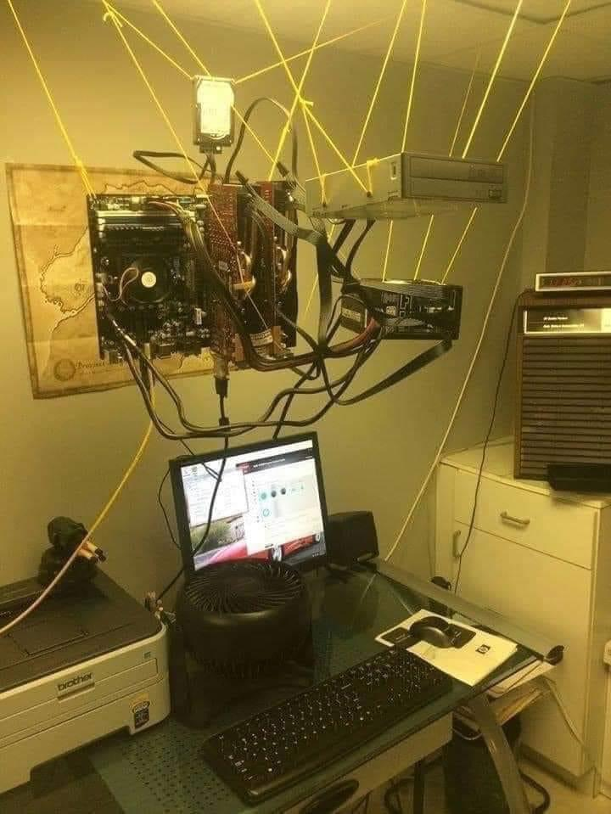
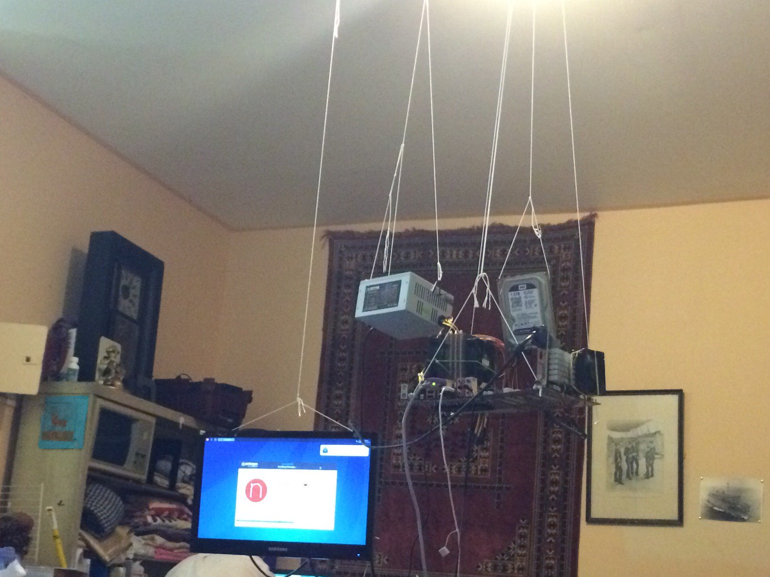
I. Hardware

Slide 36
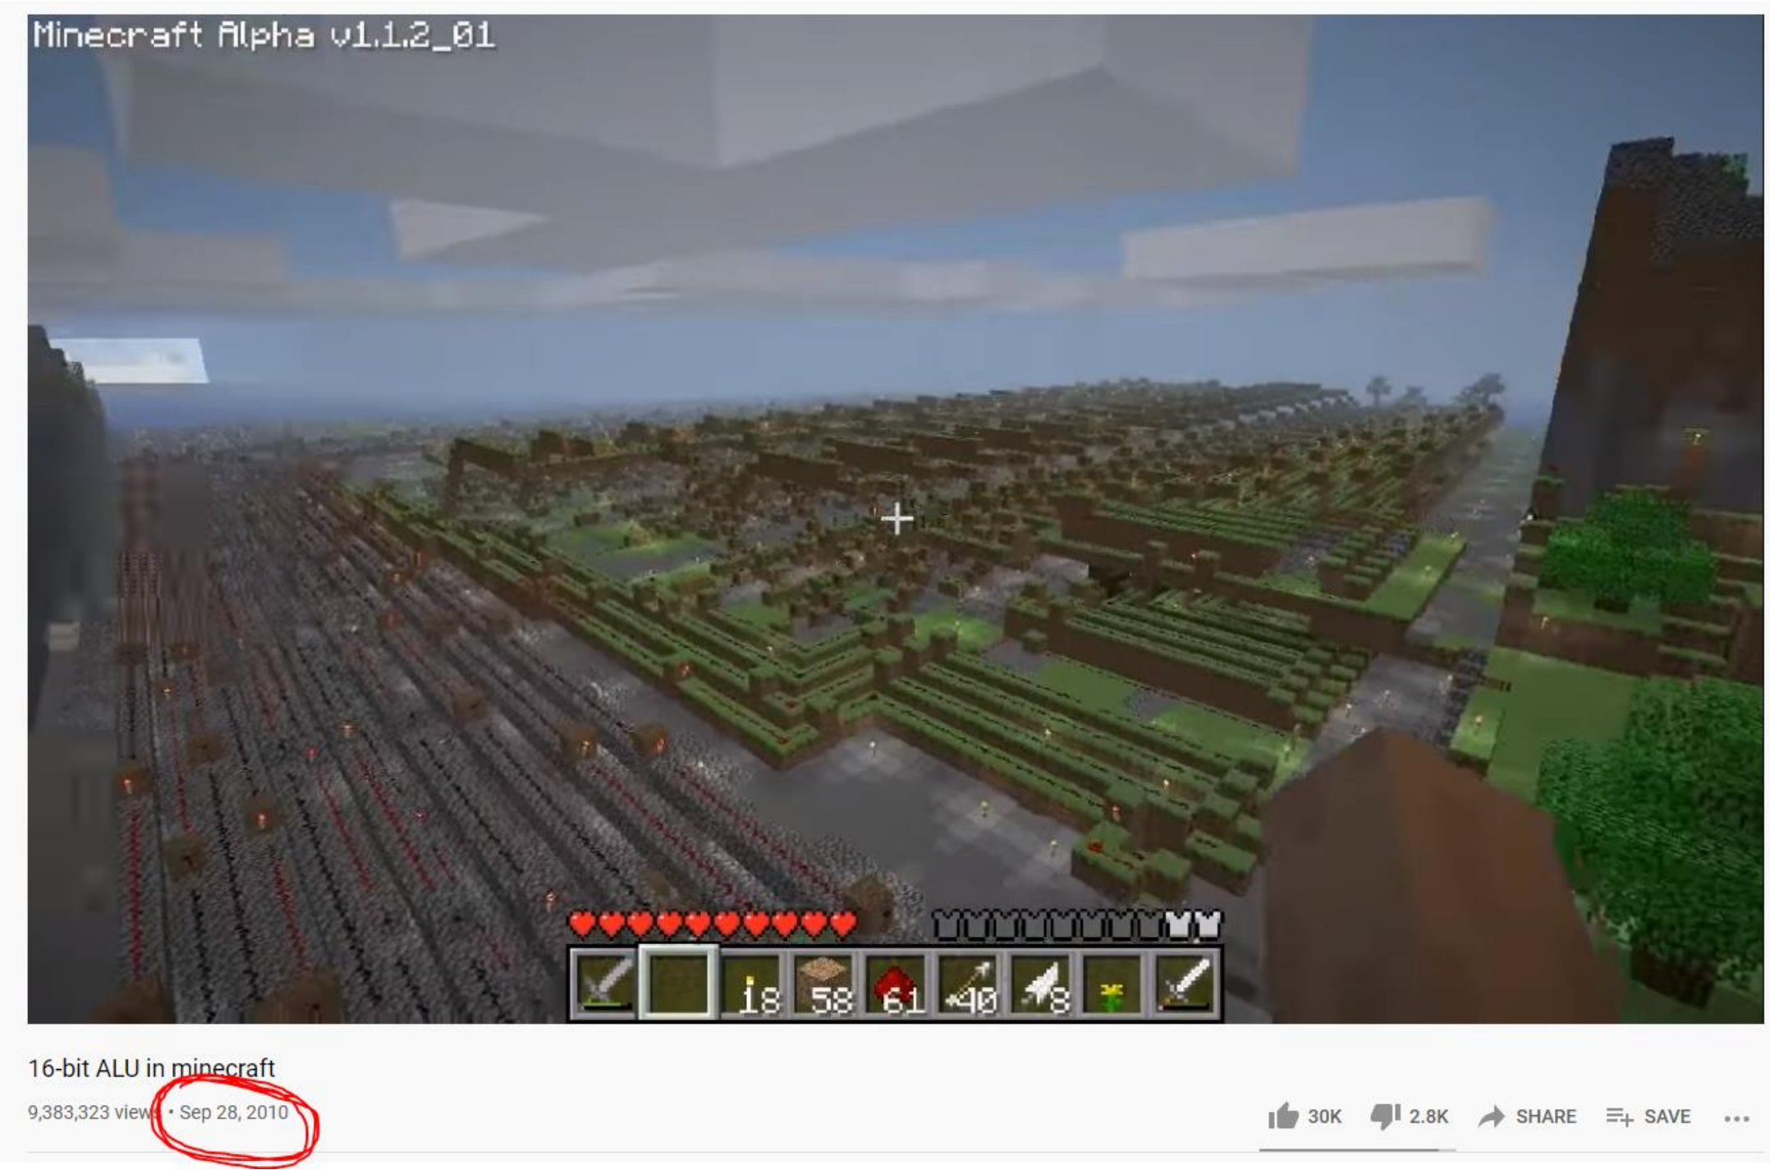
I. Hardware
People have been able to create CPU components and fully functional, multi-core computers in games such as Minecraft

Slide 37
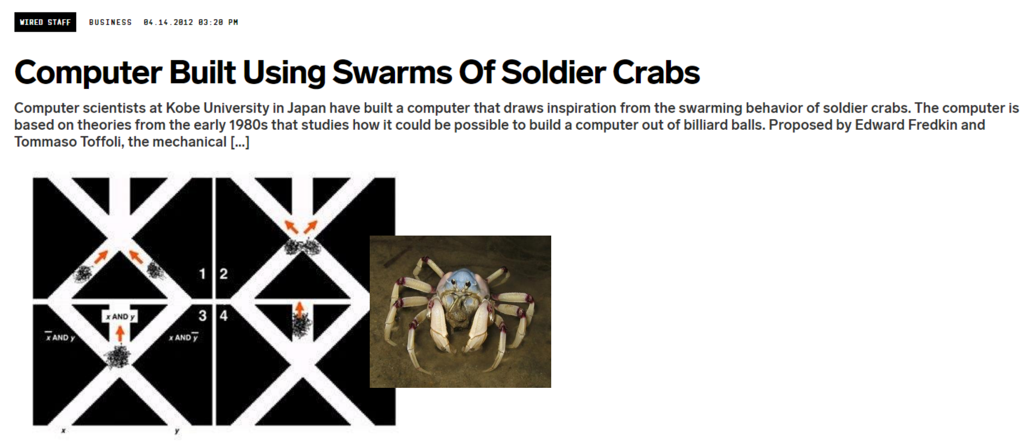
I. Hardware

Slide 38
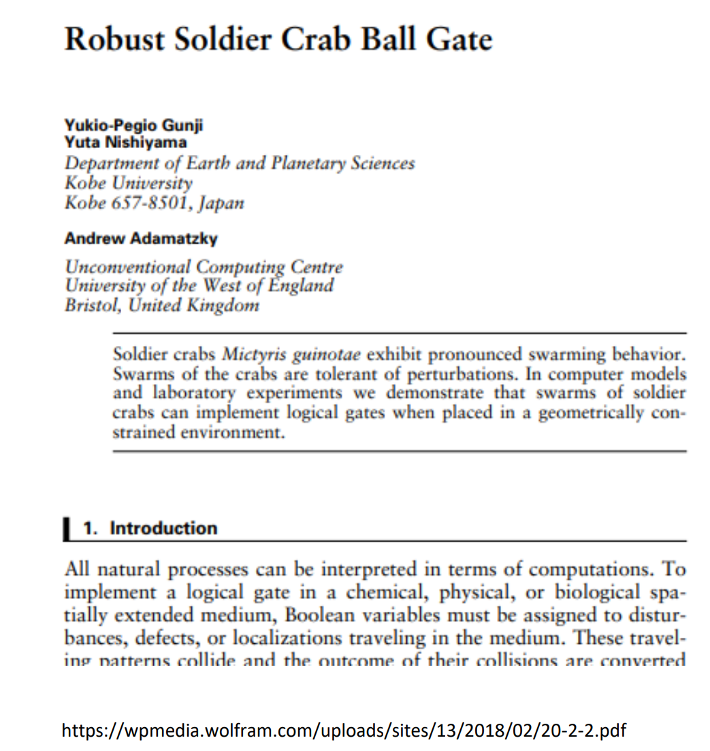
I. Hardware
This is very real

Slide 39
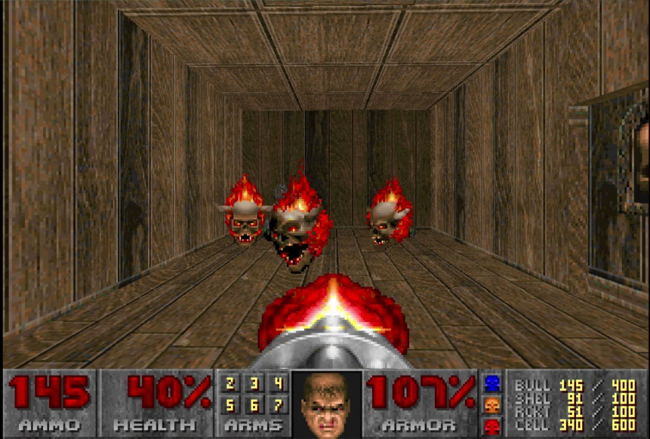
I. Hardware
(In theory) If you wanted to play Doom (1993) using a CPU made from soldier crabs, you would need 22 million crabs
(source: twitter)

Slide 40

How does this happen?
From a high level, we will divide a computer system into two parts
From a high level, we will divide a computer system into two parts
Software
Hardware
Software
Hardware
CPU
Memory
Symbiotic relationship

Slide 41






Software
A sequence of instructions, or program, that tells the computer how to work

Slide 42
Software
A sequence of instructions, or program, that tells the computer how to work
Humans (computer programmers) write software
So, do we have to write programs in 0s and 1s ???

Slide 43
Software
A sequence of instructions, or program, that tells the computer how to work
Humans (computer programmers) write software
So, do we have to write programs in 0s and 1s ???
NO!!!
(thank goodness!!)

Slide 44
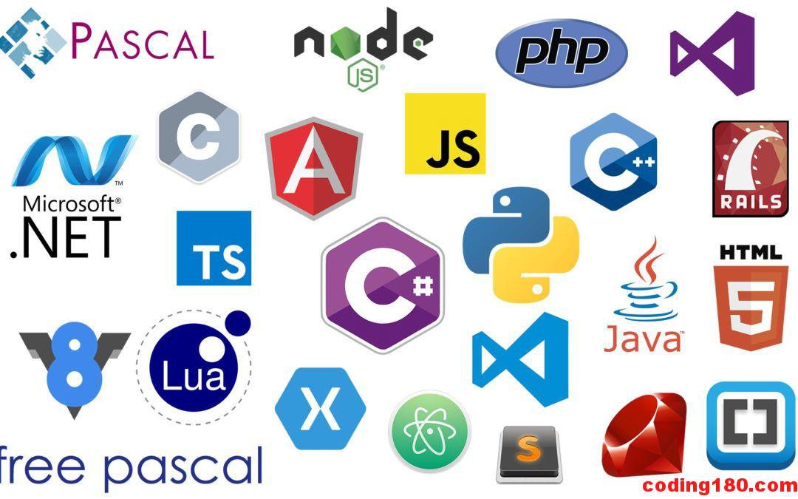


Software
We write programs in a high-level programming language
These are languages that are very easy for humans to read

Slide 45


Software
We write programs in a high-level programming language
These are languages that are very easy for humans to read

Slide 46
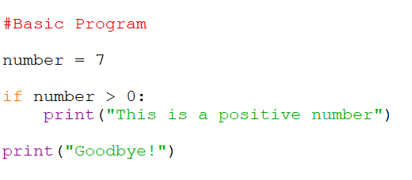
Software
A computer doesn’t understand what this means…
We need to translate it to 0s and 1s
It eventually gets translated to binary by the compiler*
*not true for every language

Slide 47
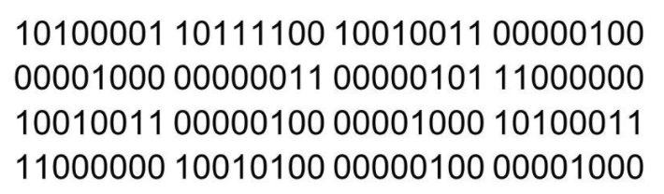

Software
A computer doesn’t understand what this means…
We need to translate it to 0s and 1s
*not true for every language

Slide 48
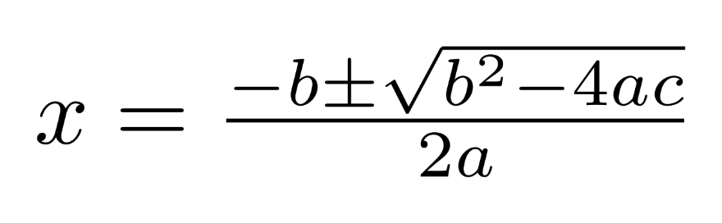
Software
An algorithm is a recipe, or a sequence of steps, for solving a problem
The quadratic formula is an algorithm for finding the roots of a quadratic equation

Slide 49
Software
An algorithm is a recipe, or a sequence of steps, for solving a problem
We have algorithms for many different problems:
Finding greatest common denominator between two values
Searching and Sorting arrays
Encrypting and compressing data
Finding the shortest path in a network
Medical diagnosis
Scheduling jobs
The quadratic formula is an algorithm for finding the roots of a quadratic equation

Slide 50
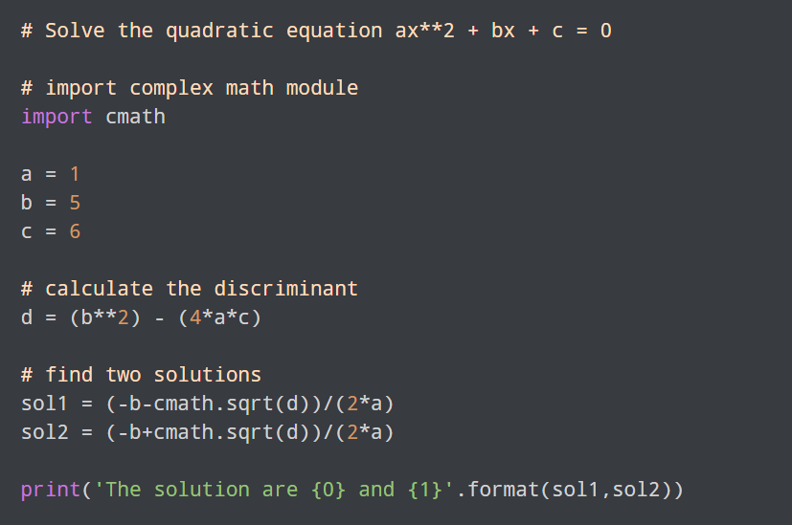
Software
An algorithm is a recipe, or a sequence of steps, for solving a problem
We implement algorithms in a program, which is a set of instructions that a computer can understand
The quadratic formula is an algorithm for finding the roots of a quadratic equation
A Python program that uses the quadratic formula algorithm

Slide 51

How does this happen?
From a high level, we will divide a computer system into two parts
Software
print(“hello world!”)
Hardware
Software
Hardware
CPU
Memory

Slide 52
How does this happen?
From a high level, we will divide a computer system into two parts
Software
print(“hello world!”)
Hardware
Software
???
Hardware
CPU
Memory

Slide 53
How does this happen?
Software
From a high level, we will divide a computer system into two parts
print(“hello world!”)
Operating System
Hardware
Software
Operating System
Hardware
CPU
Memory

Slide 54

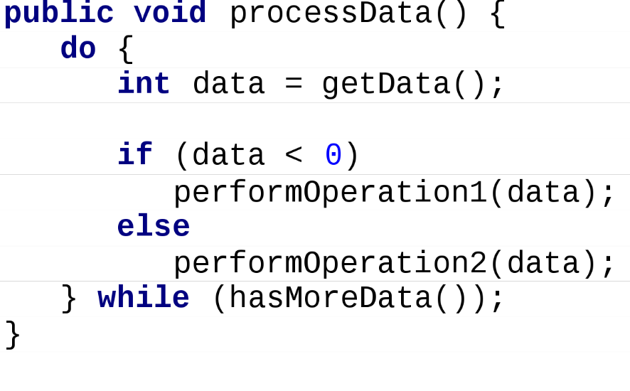
Java
In this class, we will use Java as our programming language
Why do we need more than one programming language?

Slide 55
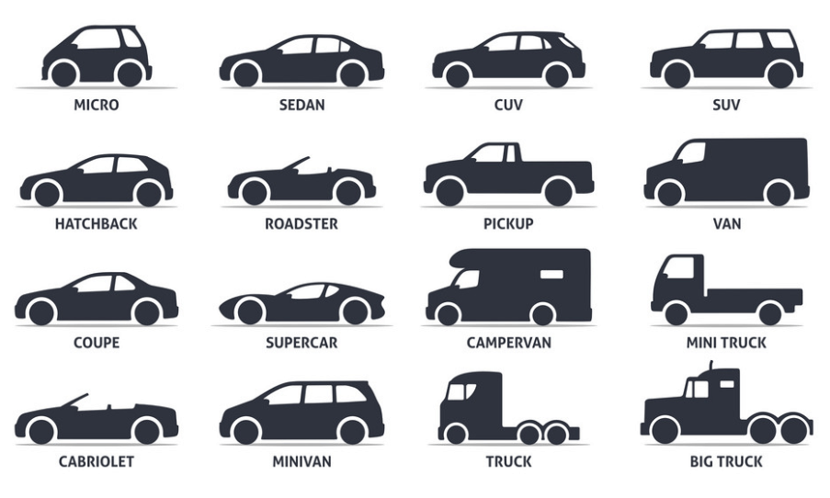
Java
In this class, we will use Java as our programming language
Why do we need more than one programming language?
Different programming languages are better for different things

Slide 56

Java vs Python
Good for developing large, commercial, distributable software
Very flexible. Good for shorter jobs, data analysis, Web development,

Slide 57
Java vs Python
Good for developing large, commercial, distributable software
Very flexible. Good for shorter jobs, data analysis, Web development,
Faster than Python
Slower than Java

Slide 58
Java vs Python
Good for developing large, commercial, distributable software
Very flexible. Good for shorter jobs, data analysis, Web development,
Faster than Python
Slower than Java
OOP Language
Functional programming language

Slide 59
Java vs Python
Good for developing large, commercial, distributable software
Very flexible. Good for shorter jobs, data analysis, Web development,
Faster than Python
Slower than Java
OOP Language
Functional programming language

Slide 60
Java vs Python
Good for developing large, commercial, distributable software
Very flexible. Good for shorter jobs, data analysis, Web development,
Faster than Python
Slower than Java
OOP Language
Functional programming language
Verbose (sigh)
Simple (but requires whitespace)

Slide 61
Java vs Python
Good for developing large, commercial, distributable software
Very flexible. Good for shorter jobs, data analysis, Web development,
Faster than Python
Slower than Java
OOP Language
Functional programming language
Verbose (sigh)
Simple (but requires whitespace)
Static Typed
Dynamic Typed

Slide 62
Java vs Python
Good for developing large, commercial, distributable software
Very flexible. Good for shorter jobs, data analysis, Web development,
Faster than Python
Slower than Java
OOP Language
Functional programming language
Verbose (sigh)
Simple (but requires whitespace)
Static Typed
Dynamic Typed

Slide 63
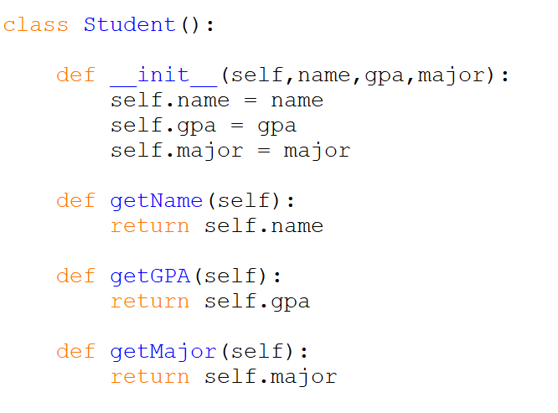
Object Oriented Programming

Slide 64

Object Oriented Programming
We write classes that is a blueprint of something

Slide 65







Object Oriented Programming
We write classes that is a blueprint of something
Classes consist of two important things:
Instance Fields/Attributes
Methods/Behaviors

Slide 66






Object Oriented Programming
We write classes that is a blueprint of something
Classes consist of two important things:
Instance Fields/Attributes
Methods/Behaviors
This program does nothing until we start creating objects

Slide 67
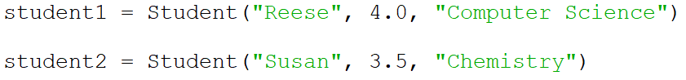
Object Oriented Programming
student1 and student2 are instances of the Student class.

Slide 68

Object Oriented Programming
1. 2. 3.
student1 and student2 are instances of the Student class.
To create an object, we called the class name, and then passed the necessary parameters/arguments
This triggers the constructor, which will create our objects
1. 2. 3.
1. 2. 3.

Slide 69
Object Oriented Programming
1. 2. 3.
student1 and student2 are instances of the Student class.
To create an object, we called the class name, and then passed the necessary parameters/arguments
1. 2. 3.
1. 2. 3.

Slide 70
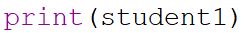
Object Oriented Programming
student1 and student2 are instances of the Student class.
An object is an encapsulation of information…
Printing/accessing an object doesn’t do much on its own…

Slide 71

Object Oriented Programming
student1 and student2 are instances of the Student class.

Slide 72
Object Oriented Programming
student1
Methods
Instance Field
name: “Reese”
GPA: 4.0
major: “Computer Science”
getName()
getMajor()
getGPA()

Slide 73
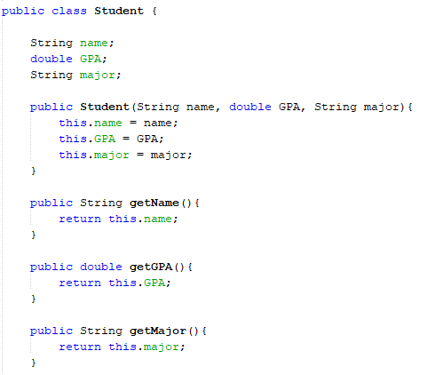
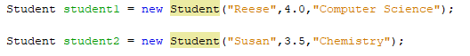
Object Oriented Programming
Java is only OOP,
all our code will be going inside of a class

Slide 74
IDE Install and creating a very basic Java Program

